Slide 1
CPU Scheduling
Santosh Kumar Verma
Mentor-GeeksforGeeks

Slide 2
CPU Scheduling
Basic Concepts
Scheduling Criteria
Scheduling Algorithms
Multiple-Processor Scheduling
Algorithm Evaluation

Slide 3
Objectives
To introduce CPU scheduling, which is the basis for multiprogrammed operating systems
To describe various CPU-scheduling algorithms
To discuss evaluation criteria for selecting a CPU-scheduling algorithm for a particular system
To examine the scheduling algorithms of several operating systems

Slide 4
Basic Concepts
Maximum CPU utilization obtained with multiprogramming
CPU–I/O Burst Cycle – Process execution consists of a cycle of CPU execution and I/O wait
CPU burst followed by I/O burst
CPU burst distribution is of main concern

Slide 5
CPU Scheduler
Short-term scheduler selects from among the processes in ready queue, and allocates the CPU to one of them
Queue may be ordered in various ways
CPU scheduling decisions may take place when a process:
1. Switches from running to waiting state
2. Switches from running to ready state
3. Switches from waiting to ready
Terminates
Scheduling under 1 and 4 is non-preemptive
All other scheduling is preemptive
Consider access to shared data
Consider preemption while in kernel mode
Consider interrupts occurring during crucial OS activities

Slide 6
Dispatcher
Dispatcher module gives control of the CPU to the process selected by the short-term scheduler; this involves:
switching context
switching to user mode
jumping to the proper location in the user program to restart that program
Dispatch latency – time it takes for the dispatcher to stop one process and start another running

Slide 7
Scheduling Criteria
CPU utilization – keep the CPU as busy as possible
Throughput – # of processes that complete their execution per time unit
Turnaround time – amount of time to execute a particular process
Waiting time – amount of time a process has been waiting in the ready queue
Response time – amount of time it takes from when a request was submitted until the first response is produced, not output (for time-sharing environment)

Slide 8
Scheduling Algorithm Optimization Criteria
Max CPU utilization: Upto 100% busy.
Max throughput: Max processes per unit time.
Min turnaround time: How long it take to execute the process (incl. Wait for memory and ready queue, CPU, and IO)
Min waiting time: Total time in ready queue only
Min response time: The time it takes to respond.

Slide 9
First- Come, First-Served (FCFS) Scheduling
Process Burst Time
P₁ 24
P₂ 3
P₃ 3
Suppose that the processes arrive in the order: P₁ , P₂ , P₃ The Gantt Chart for the schedule is:
Waiting time for P₁ = 0; P₂ = 24; P₃ = 27
Average waiting time: (0 + 24 + 27)/3 = 17

Slide 10
FCFS Scheduling (Cont.)
Suppose that the processes arrive in the order:
P₂ , P₃ , P₁
The Gantt chart for the schedule is:
Waiting time for P₁ = 6; P₂ = 0; P₃ = 3
Average waiting time: (6 + 0 + 3)/3 = 3
Much better than previous case
Convoy effect - short process behind long process
Consider one CPU-bound and many I/O-bound processes
Not Suitable for Time-sharing systems

Slide 11
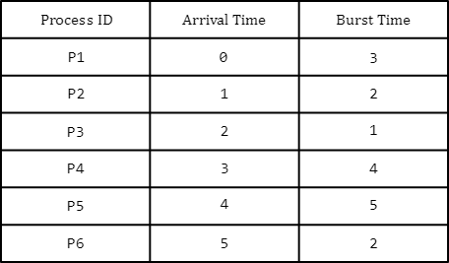
The arrival time and burst times for a set of 6 processes are given in the table below. If FCFS Scheduling Algorithm is followed and there is 1 unit of overhead in scheduling the processes, find the algorithm's efficiency.
Practice

Slide 12
Shortest-Job-First (SJF) Scheduling
Associate with each process the length of its next CPU burst
Use these lengths to schedule the process with the shortest time
SJF is optimal – gives minimum average waiting time for a given set of processes
It Could be preemptive as well as non-pre-emptive
Preemptive version called shortest-remaining-time-first

Slide 13
Example of SJF( Non-Preemptive)
ProcessArrival Time Burst Time
P₁ 0.0 6
P₂ 2.0 8
P₃ 4.0 7
P₄ 5.0 3
SJF scheduling chart
Average waiting time = (3 + 16 + 9 + 0) / 4 = 7

Slide 14
Example of Shortest-remaining-time-first
Now we add the concepts of varying arrival times and preemption to the analysis
ProcessA arri Arrival TimeT Burst Time
P₁ 0 8
P₂ 1 4
P₃ 2 9
P₄ 3 5
Preemptive SJF Gantt Chart
Average waiting time = [(10-1-0)+(1-0-1)+(17-0-2)+(5-0-3)]/4 = 26/4 = 6.5 msec
Waiting Time = Total Waiting Time – No. of milliseconds process executed – Arrived Time.

Slide 15
Disadvantages of SJF Scheduling Algorithm
The real difficulty with the SJF algorithm is knowing the length of the next CPU request
Although the SJF algorithm is optimal, it cannot be implemented at the level of short-term CPU scheduling.
There is no way to know the length of the next CPU burst.
Approach to use SJF scheduling algorithm is:
To try to approximate SJF scheduling
We may not know the length of the next CPU burst, but we may be able to predict its value.
We may expect that the next CPU burst will be similar in length to the previous ones.
Thus, by computing an approximation of the length of the next CPU burst, we can pick the process with the shortest predicted CPU burst

Slide 16
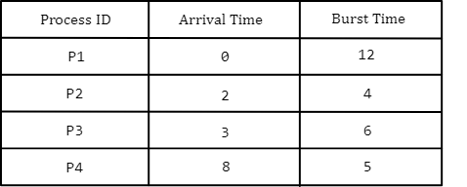
Gate 2014
An operating system uses the shortest remaining time first scheduling algorithm for pre-emptive scheduling of processes. Consider the following set of processes with their arrival times and CPU burst times (in milliseconds):
The average waiting time (in milliseconds) of the processes is _____________.
(A)4.5 (B) 5.0 (C)5.5 (D) 6.5

Slide 17
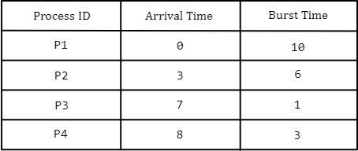
Gate 2016
Consider the following processes, with the arrival time and the length of the CPU burst given in milliseconds. The scheduling algorithm used is preemptive shortest remaining-time first.
The average turnaround time of these processes is _____________ milliseconds.
(A)8.25 (B) 10.25 (C)6.35 (D)4.25

Slide 18
Priority Scheduling
A priority number (integer) is associated with each process
The CPU is allocated to the process with the highest priority (smallest integer ≡ highest priority)
Preemptive
Non-preemptive
SJF is priority scheduling where priority is the inverse of predicted next CPU burst time
Problem ≡ Starvation – low priority processes may never execute
Solution ≡ Aging – as time progresses increase the priority of the process

Slide 19
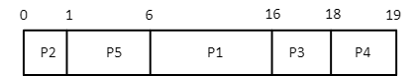
Example of Priority Scheduling
ProcessA arri Burst TimeT Priority
P₁ 10 3
P₂ 1 1
P₃ 2 4
P₄ 1 5
P₅ 5 2
Priority scheduling Gantt Chart
Average waiting time = 8.2 msec
Waiting Time for P1 = 6 milliseconds.
Waiting Time for P2 = 0 milliseconds.
Waiting Time for P3 = 16 milliseconds.
Waiting Time for P4 = 18 milliseconds.
Waiting Time for P5 = 1 milliseconds.
So, the Average Waiting Time = (6+0+16+18+1)/5 = 8.2 milliseconds.

Slide 20
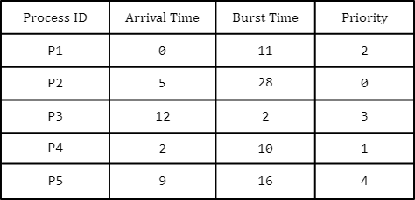
Gate 2017
Consider the set of processes with arrival time (in milliseconds), CPU burst time (in milliseconds), and priority (0 is the highest priority) shown below. None of the processes has I/O burst time.
The average waiting time (in milliseconds) of all the processing using preemptive priority scheduling algorithm is _________________.
(A) 29 (B) 30 (C)31 (D)32

Slide 21
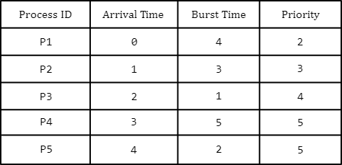
Practice
Consider the set of processes with arrival time (in milliseconds), CPU burst time (in milliseconds), and priority shown below. (Higher number represents higher priority).
If the CPU scheduling policy is priority non-preemptive, calculate the average waiting time and average turnaround time.

Slide 22
Round Robin (RR)
Each process gets a small unit of CPU time (time quantum q), usually 10-100 milliseconds. After this time has elapsed, the process is preempted and added to the end of the ready queue.
If there are n processes in the ready queue and the time quantum is q, then each process gets 1/n of the CPU time in chunks of at most q time units at once. No process waits more than (n-1)q time units.
Timer interrupts every quantum to schedule next process
Performance
q large ⇒ FIFO
q small ⇒ q must be large with respect to context switch, otherwise overhead is too high

Slide 23
Example of RR with Time Quantum = 4
Process Burst Time
P₁ 24
P₂ 3
P₃ 3
The Gantt chart is:
Typically, higher average turnaround than SJF, but better response
q should be large compared to context switch time
q usually 10ms to 100ms, context switch < 10 microsec
Turn Around Time = Completion time - Arrival Time
Waiting Time = Turn Around Time – Burst Time
Waiting Time = Last Start Time -Arrival Time – (Preemption * Time Quantum)

Slide 24
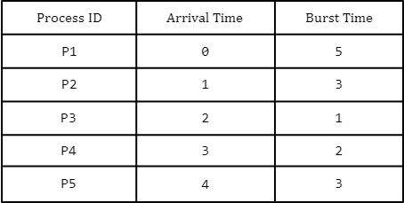
Practice
Consider the set of 5 processes whose arrival time and burst time are given below:
If the CPU scheduling policy is Round Robin with time quantum = 2 units, calculate the average waiting and turnaround times.

Slide 25
Multilevel Queue
Ready queue is partitioned into separate queues, eg:
foreground (interactive)
background (batch)
Process permanently in a given queue
Each queue has its own scheduling algorithm:
foreground – RR
background – FCFS
Scheduling must be done between the queues:
Fixed priority scheduling; (i.e., serve all from foreground then from background). Possibility of starvation.
Time slice – each queue gets a certain amount of CPU time which it can schedule amongst its processes; i.e., 80% to foreground in RR
20% to background in FCFS

Slide 26
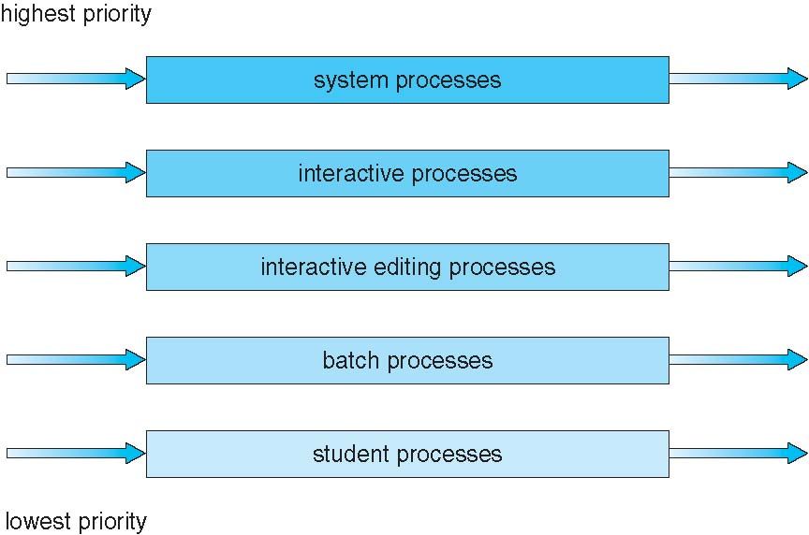
Multilevel Queue Scheduling

Slide 27
Multilevel Feedback Queue
A process can move between the various queues; aging can be implemented this way
Multilevel-feedback-queue scheduler defined by the following parameters:
number of queues
scheduling algorithms for each queue
method used to determine when to upgrade a process
method used to determine when to demote a process
method used to determine which queue a process will enter when that process needs service

Slide 28
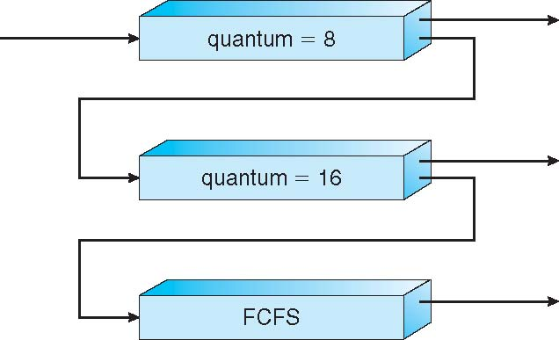
Example of Multilevel Feedback Queue
Three queues:
Q₀ – RR with time quantum 8 milliseconds
Q₁ – RR time quantum 16 milliseconds
Q₂ – FCFS
Scheduling
A new job enters queue Q₀ which is served FCFS
When it gains CPU, job receives 8 milliseconds
If it does not finish in 8 milliseconds, job is moved to queue Q₁
At Q₁ job is again served FCFS and receives 16 additional milliseconds
If it still does not complete, it is preempted and moved to queue Q₂

Slide 29
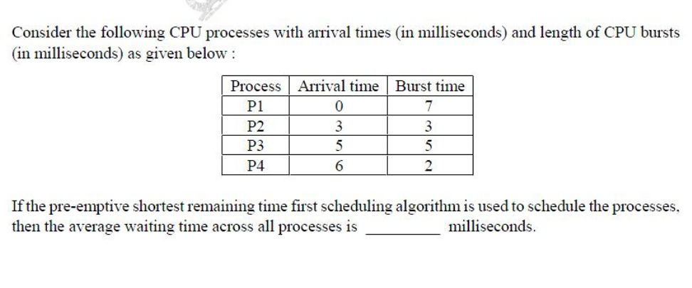
Gate 2017
3.0

Slide 30
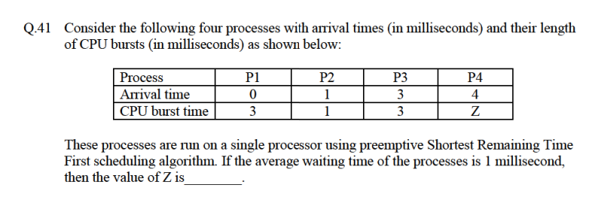
Gate 2019
2

Slide 31
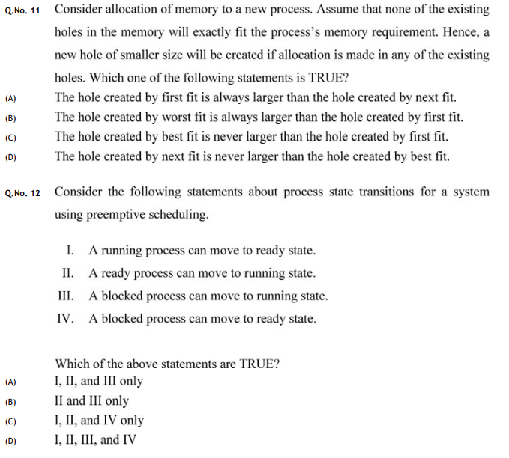
Gate 2020

Slide 32
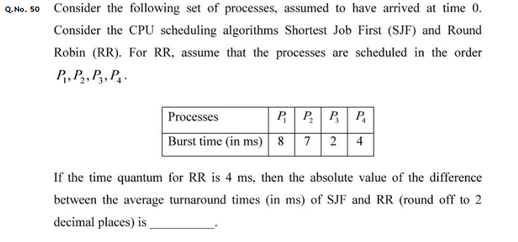
Gate 2017
5.25

